Slide 1
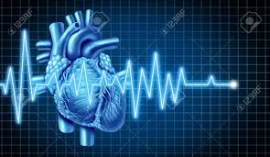
DRIVERS AUTO-HEART MONITORING SYSTEM
GANAPATHY U E
AKHIL V
AKSHAY BALACHANDRAN

Slide 2
INTRODUCTION
“Projects are done so as to improve the way we live, if it doesn’t, then its like a dead rubber. Through this project , we try our bit to enhance the health sector which makes our life easier”
Project to help mankind.
Project to improve health sector as it in turn improves the quality of life.
Cost effective and can be implemented with great accuracy.

Slide 3
METHODOLOGY
The project make use of 3 different sensors which act as inputs to the main controller.
AURDINO
HEART RATE SENSOR
PULSE RATE SENSOR
ECG SENSOR
OUTPUT
OUTPUT
RASPBERRY PI

Slide 4
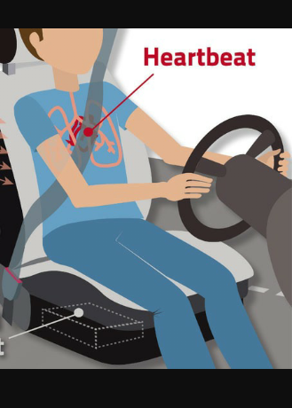
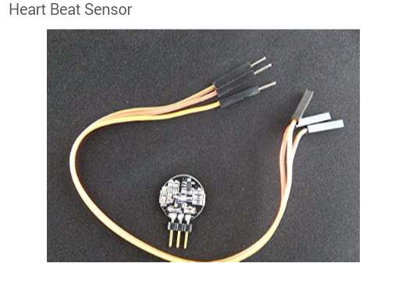
SENSORS
HEARTBEAT SENSOR-The Heart sensor or the heartbeat sensor takes in the values of the heartbeats of the driver.
Position-Placed on the seatbelt such that it can constantly be on touch with the left hand side of chest.

Slide 5
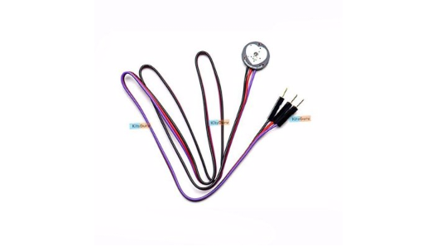
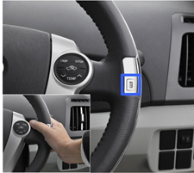
PULSE RATE SENSOR-The Pulse Rate Sensor evaluates the pulse of the driver and is fed to the Microcontroller.
Position-Placed on the steering in such a way that the fingers are always In contact with the sensor to take in the value.

Slide 6
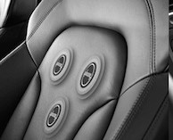
ECG SENSOR – The ECG(Electro Cardio Graph) Sensor is placed on the backrest of the driver in just a way that real time ECG variations can be monitored and fed to the Microcontroller.

Slide 7
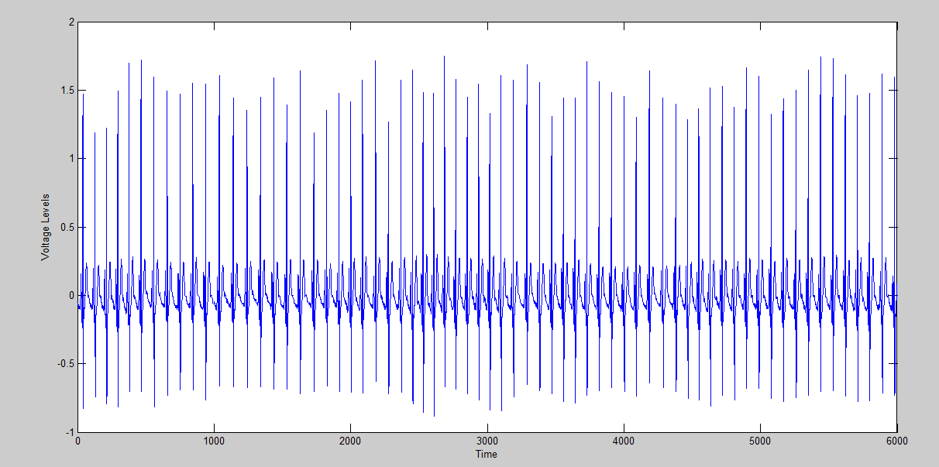
NORMAL ECG LEVEL

Slide 8
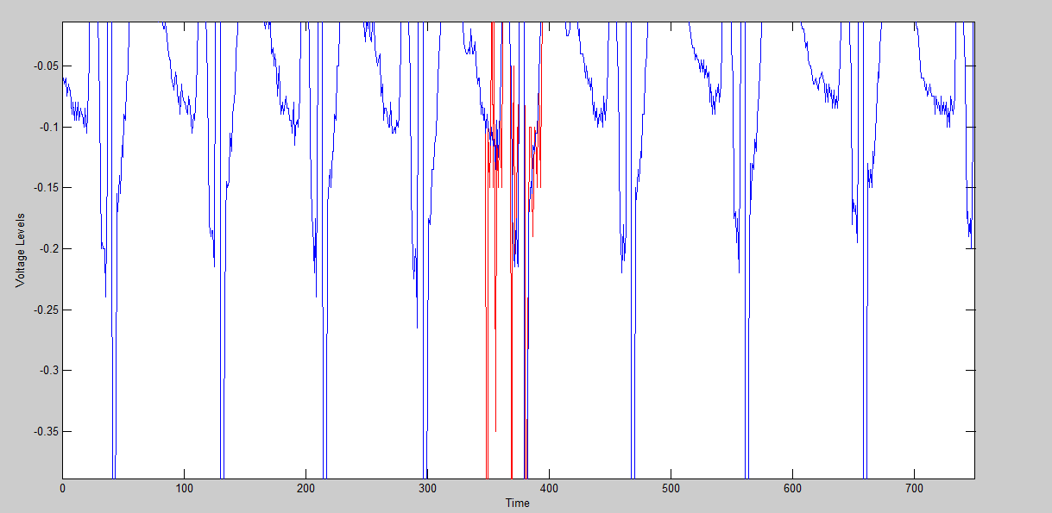
VARIATION FROM NORMAL ECG LEVEL

Slide 9
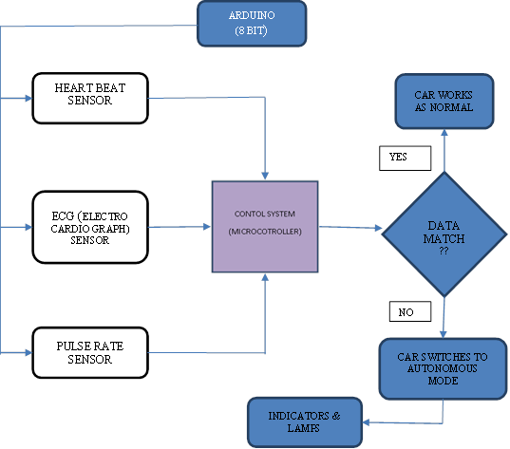
BLOCK DIAGRAM

Slide 10
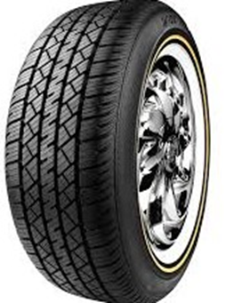
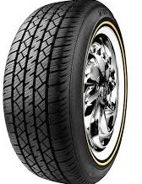
BRAKING SYSTEM
The normal braking System in a car consist of a pedal, a braking chamber and a connector which takes the Hydraulic fluid to the braking chamber.
BRAKE FLUID

Slide 12
.The braking system can be designed in a way that the brake fluid can be bypassed to the braking chamber without the driver actually pressing the pedal in case of situation when driver looses the control over it.

Slide 13
THANK YOU.

